Slide 1
LET YOUR VOICE BE HEARD COMMUNITY FORUM
05/21/2017
** PLEASE USE SIGN IN SHEET IF YOU WISH TO MAKE AN ANNOUCEMENT **

Slide 2
TONIGHT’S KEY TOPICS
RECAP OF LAST MEETING
RECAP OF EVENTS SINCE LAST FORUM
UPCOMING OUTREACH EVENTS
DIRECTION OF LET YOUR VOICE BE HEARD’S MISSION
FINDING ROLES IN LET YOUR VOICE BE HEARD EVENTS
JUNE 17TH YOUTH CRIME PREVENTION AND EMPLOYABILITY WORKSHOP/ STAR 94.5 HEALTH FAIR AND FUTURE YOUTH WORKSHOPS
JULY 8TH COMMUNITY CARE FAIR RESOURCES EXPO
PLANNING FUTURE WORKSHOPS
CITY AND COUNTY COUNCIL MEETINGS
NEWSLETTER/ APPAREL
OPEN FLOOR/ANNOUCEMENTS

Slide 3
RECAP OF LAST MEETING
WWW.LETYOURVOICEBEHEARDINC.COM IS OFFICIALLY UP AND RUNNING
MOVING FORWARD:
Community forums will take place on the last Sunday of the month
Community outreach walks will take place on the 2nd Saturday afternoon of each month at 12:00pm (locations vary monthly, last date was 05/20/2017, we met up at Jackson community center (1002 carter st.) and performed outreach in the Parramore neighborhood
Community peace walks will take place on the 3rd Saturday evening of each month at 6:30 pm (locations vary monthly in accordance with the community outreach walks, next date will be 05/27/2017 meeting at Jackson community center (1002 carter st) performing a peace walk/outreach in the Parramore neighborhood
(STARTING JUNE 17TH, 2017) Youth workshops will take place one Saturday morning of each month at 9:00 am (location will be holden heights community center)
Youth afterschool outreach is every Thursday afternoon at evans high school and Friday afternoon at jones hight school (Robinswood middle school is postponed until 2017-2018 school year)
Our large community day will take place 07/08/2017 in the form of the community resource fair expo “community care fair”
We will have more charitable events such as our food and clothes drives for the homeless, community clean ups, job fairs and more

Slide 4
RECAP OF EVENTS SINCE LAST FORUM
Youth outreach has continued every Thursday at evans high school and Fridays at jones high school
Evans high school meet up at arc Christian center (5005 silver star rd Orlando, fl)
Jones highs chool met up is at corner of rio grande ave & gore st
We meet at 2:15 pm at each location
We can use:
Volunteers
Chips, drinks, ice
Monetary donations
Gofundme: let your voice be heard comm. forum

Slide 5
RECAP OF EVENTS SINCE LAST FORUM
March 30th, 2017- freedom ride for justice
We met up at Walmart and loaded on coach buses to travel to Tallahassee to rally at the capitol in front of senators and house representatives and the governor’s office in opposition of the choice to remove state attorney aramis ayala from the Markeith loyd case and 23 other capital first degree murder cases
We numbered in the hundreds and had speakers and people from all over the state from Miami to Tallahassee
It was a powerful event and the start of many more events to come such as townhalls, rallies and more discussions

Slide 6
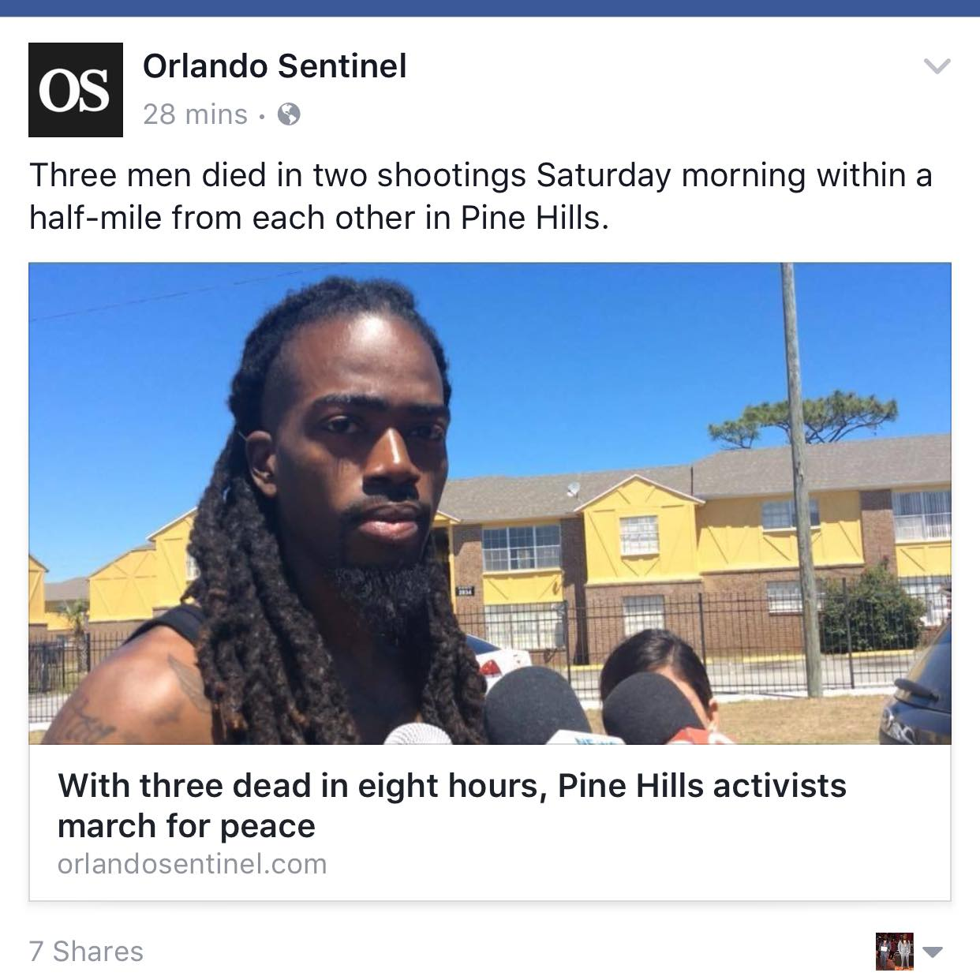
RECAP OF EVENTS SINCE LAST FORUM
April 8th, 2017- community outreach walk
We met up at the winn dixie located at silver star and pine hills rd and ventured into the pine hills neighborhood towards powers dr. visiting apartment complexes and residents in the area
We numbered at around 30 participants
We conducted survey and provided information to residents about upcoming events and programs
There was a double homicide before we met for outreach and there was a homicide committed while we were conducting the outreach
We still persevered and ended up making headlines for the walk

Slide 7
RECAP OF EVENTS SINCE LAST FORUM
April 19th, 2017- crime survivors vigil in Tallahassee
We conducted a vigil in Tallahassee with our national partners based out of California, alliance for safety & justice , for the “crime survivors” program we’re bringing to Florida
Crime survivors focuses on re-directing resources and needs to the families of victims of crime in forms of monetary compensation, medical expenses, mental health and social services and more

Slide 8
RECAP OF EVENTS SINCE LAST FORUM
April 22nd, 2017- Florida rights restoration coalition 2nd chance workshop
Florida rights restoration coalition conducted a 2nd chance workshop where persons with records were able to apply to have their records sealed or expunged and if qualified, scholarships for the costs were available
Everyone wasn’t able to qualify but the persons who were was able to have their record sealed or expunged on the spot with vendors from the orange county government readily available and conducting expungements and seals on the scene
A great event and the next one will take place in the Parramore neighborhood

Slide 9
RECAP OF EVENTS SINCE LAST FORUM
April 29th, 2017- community peace walk
We met up at 6:30 pm at the winn dixie located at silver star and pine hills rd and ventured into the pine hills neighborhood towards powers dr. visiting apartment complexes and residents in the area
We numbered at around 16 participants
We did not conduct surveys but simply walked through and interacted with residents

Slide 10
RECAP OF EVENTS SINCE LAST FORUM
May 20th, 2017- community outreach walk
We met at the Jackson community center (1002 carter st) and ventured in the Parramore neighborhood
We conducted surveys and interacted with residents and provided newsletter and handouts for resourceful programs and companies
We will continue with the community peace walk next Sunday at 6:30 pm accompanied by monica may of star 94.5

Slide 11
UPCOMING OUTREACH EVENTS
Youth outreach
Community peace walk 05/27/2017
Community outreach walk 06/10/2017 & Community peace walk 06/17/2017
Community food and clothing drive
Clean-ups and community give-back days

Slide 12
YOUTH OUTREACH
Each week we go out after school and greet the youth with chips and drinks and snacks and also provide them with information on how to get into various programs that offer community service opportunities that can be used for any purpose and even employment opportunities
Since we have started we have got a great response for the youth and many have signed up for the opportunities we’ve presented to them
WE HAVE SET DAYS OF THE WEEK WE DO OUTREACH AND WE CAN USE VOLUNTEERS AND DONATIONS ON A CONSISTENT BASIS
WE ARE WORKING ON SECURING SOME CORPORATE SPONSORS FOR OUR EVENTS, WE ARE PENDING TAX EXEMPT STATUS
IF YOU WISH TO MAKE A CASH Donation YOU CAN GO TO https://www.gofundme.com/let-your-voice-be-heard-comm-forum
PLEASE SIGN UP IF YOU’RE INTERESTED

Slide 13
YOUTH OUTREACH
WE GO OUT ON WEDNESDAYS TO WE WILL GO OUT ON THURSDAYS TO EVANS HIGH SCHOOL AT 2:15PM
MEET AT ARC CHRISTIAN CENTER (5005 SILVER STAR ROAD)
WE GO ON FRIDAYS TO JONES HIGH SCHOOL AT 2:15PM
MEET AT RIO GRANDE AND GORE ST
WE ALSO SPEAK WITH THE YOUTH ABOUT THE IMPORTANCE OF STAYING IN SCHOOL AND NEGATIVE INFLUENCES
WE CAN USE DONATIONS OF CHIPS AND DRINKS AND SNACKS

Slide 14
Community peace walk
Our next community peace walk will take place 05/27/2017
We will meet in same location that we meet for the community outreach walk at 6:30 pm (Jackson community center basketball court parking lot 1002 carter st. Orlando, fl )
This Is meant to be a form of neighborhood watch and outreach but we do not have to engage any crimes or suspected activities, our presences in the neighborhood are the main goal
We will have on white shirts (you can have let your voice be heard shirts on or any shirt of your choice) to symbolize peace
Anyone is welcome to speak and interact with residents and offer aids and assistance (such as the handouts for outreach) and we will have persons conducting surveys and providing handouts but interaction is not required
It will not be a march, but a simple peace walk through various neighborhoods

Slide 15
Community outreach walk 06/10/2017 & Community peace walk 06/17/2017
WE WILL CHOOSE A LOCATION FOR OUR NEXT COMMUNITY OUTREACH WALK AND PEACE WALK
AREAS IN THE PAST HAVE BEEN THE PINE HILLS & PARRAMORE NEIGHBORHOOD
SOME SUGGESTED AREAS ARE : IVEY LANE, MERCY DR., CARVER SHORES, WASHINGTON SHORES, SEMORAN RD, PINE HILLS, PARRAMORE
WE WILL CONTINUE OUTREACH WITH SMALL GROUPS OF VOLUNTEERS THROUGH PAST LOCATIONS WE’VE CONDUCTED OUTREACH AT
THE GOAL IS TO SPREAD AWARENESS THROUGH VARIOUS LOCATIONS BUT IT IS IMPOSSIBLE TO COVER AN ENTIRE NEIGHBORHOOD IN ONE OUTING SO WE CAN RE VISIT AREAS

Slide 16
COMMUNITY OUTREACH- food/CLOTHING drive
OUR LAST FOOD & CLOTHING DRIVE FOR THE HOMELESS WAS MARCH 18TH, 2017 WITH SAVING OUR DAUGHERS
AT THESE FOOD/CLOTHING DRIVES WE GAVE OUT NEW AND GENTLY USED CLOTHES TO FAMILIES IN NEED AND ALSO HAVE CANNED GOODS AND HOT MEALS PREPARED FOR ANYONE WHO WANTS
WE HAD A GREAT TURNOUT FROM VOLUNTEERS AND DONATIONS
WE WILL CONTINUE THESE, THE TARGET WAS EVERY 3 MONTHS
PLEASE LET US KNOW IF YOU’RE INTERESTED IN COORDINATING/VOLUNTEERING
WE WILL HAVE MORE INFORMATION ON OUR NEXT ONE SOON

Slide 17
CLEAN-UPS/ GIVE BACKS
WE CAN CHOOSE AN AREA EACH MONTH TO CHOOSE TO CLEAN UP AND PICK UP TRASH AND BEAUTIFY
ALSO SUGGESTIONS ARE COMMUNITY FUN DAYS WITH GIVE AWAYS FOR BOOKBAGS, BIKES, CLOTHES, SUPPLIES, ETC
WE HAVE A HUGE EVENT JULY 8TH AT THE FAIRGROUNDS THAT CAN BE USED TO GIVE AWAY TO ATTENDANTS

Slide 18
DIRECTION OF LET YOUR VOICE BE HEARD’S MISSION
OUR SOLE MISSION IS TO EMPOWER COMMUNITIES AND DETER VIOLENCE AT THE SAME TIME.
WE CHOOSE TO ACCOMPLISH THIS THROUGH:
WORKSHOPS THAT GIVE RESIDENTS SKILLS THAT WILL HELP BRING IN REVENUE AND REDUCE THE NEED TO RESORT TO CRIMINAL MEANS
OUTREACH EVENTS IN WHICH WE PROVIDE INFORMATION TO PERSONS AT NEED OR INTERESTED IN TAKING ADVANTAGE OF RESOURCES AVAILABLE
COMMUNITY EVENTS AND FUN DAYS THAT WILL HELP BOOST MORALE AND THE POSITIVE ATMOSPHERE
MENTORING PROGAMS TO HELP GUIDE YOUTH AND LEAD THEM TO NEW INSIGHTS
COMMUNITY CHARITABLE EVENTS THAT CATER AND SERVICE THE LESS FORTUNATE
PEACE WALKS, RALLIES, MARCHES, DRIVES, ETC. THAT HELP MEMBERS OF COMMUNITIES TO STAND TOGETHER IN SOLIDARITY AND BAND TOGETHER

Slide 19
FINDING ROLES IN LET YOUR VOICE BE HEARD events
Regularly we will need:
Volunteers who can help set-up, distribute and facilitate events
Coordinators who can help lock in plans and solidify operational items for events (such as booking speakers, artists, arranging food services, reaching out to volunteers, etc)
We will conduct meetings outside of the forum for let your voice be heard members to coordinate and run events
Sponsors (anyone who wants to fiscally sponsor an event can find out what events ar taking place and coordinate with us)
Speakers/ facilitators for workshops

Slide 20
JUNE 17TH YOUTH CRIME PREVENTION AND EMPLOYABILITY WORKSHOP/ STAR 94.5 HEALTH FAIR AND FUTURE YOUTH WORKSHOPS
The youth crime prevention workshops will work in collaboration with a program entitled “Hood 2 Hood,” crisis mentoring to at-risk youth and high crime filled areas in the form of which includes mentors responding to calls for mentoring whether its due to a crime that a youth has been the victim of or is accused of committing, or is “at risk” to be a victim or offender
The curriculum will consist of key topics such as crime prevention, mental health, political awareness, employment and employability skills, entrepreneurship, history, technology, technical fields, economic responsibility and more
We will have guest speakers with professional fields and experience in relation to the key topics that will present life examples of successes and failures, provide keys and strategies and connect with the youth one on one to help guide the youth after the workshops towards new beginnings.

Slide 21
JULY 8TH COMMUNITY CARE FAIR RESOURCES EXPO
We have a huge community day in which we will be at the central florida fairgrounds in an inside venue that can fit 5,000 attendants
The event will feature vendor tables, special guest speakers, scenarios and roleplay, live entertainment, festivities for the community, radio and news stations, organization partnerships, food and drinks and more
The expo will feature designated areas where attendants can interact with professionals who will present on themes based in their field
We are in the process of publishing a finalized flyer that will include the logos of each vendor and partner that will be at this event.

Slide 22
JULY 8TH COMMUNITY CARE FAIR RESOURCES EXPO
There are partnership opportunities for this event if any organization wishes to be an official partner in the form of sponsorship packages that would go towards promotion, publication and other fees.
We will need volunteers to help promote this event and for the day of the event
If you wish to be a vendor please let us know and we can send you the information to sign up
Vendor tables are $50 but admission to the event is free

Slide 23
PLANNING FUTURE WORKSHOPS
WE HAVE HOSTED AND CO-HOSTED LEGAL RIGHTS, GRANT-WRITING, MENTAL HEALTH AND OTHER VARIOUS WORKSHOPS IN THE PAST
IN THE FUTURE WE PLAN TO WORK ON WORKSHOPS FOR AREAS AND SUBJECTS SUCH AS CREDIT REPAIR, FIRST TIME HOME BUYER’S PROGRAM, FINANCIAL INVESTMENT, ANCESTRY RESEARCH, SPIRITUAL, AND MANY MORE DIFFERENT VERSIONS OF WORKSHOPS
WE WILL WORK WITH PROFESSIONALS WHO ARE REFERRED TO US, AFTER WE HAVE RESEARCHED AND ESTABLISHED THAT EACH PROFESSIONAL IS BEST SUITED TO FACILIATE THESE WORKSHOPS
WE ALSO HAVE A YOUTH SERIES OF WORKSHOPS THAT WILL FOCUS ON AREAS SUCH AS ANTI-BULLYING, SELF ESTEEM, PEER PRESSURE, SOCIAL MEDIA, AND MORE.
WORKSHOPS WILL TAKE PLACE ON THE LAST FRIDAY OF EACH MONTH FOR ADULTS AND ON THE LAST SATURDAY OF EACH MONTH FOR THE YOUTH

Slide 24
CITY COUNCIL AND ORANGE COUNTY MEETINGS
We can meet at Forums and among ourselves but unless we propose our ideas to the elected officials of the local government, changes will not be made
If we don’t attend meetings we can look up our local officials online and write them with our concerns, there is power in keeping records of our requests.
We have to do research on each topic we suggest to have changed
Send ideas to info@letyourvoicebeheardinc.com
SIGN UP IF YOU WILL LIKE UPDATES AND TO ATTEND THE NEXT MEETING WITH US

Slide 25
CITY COUNCIL AND ORANGE COUNTY MEETINGS
UPCOMING AGENDA FOR ORLANDO CITY COUNCIL MEETING:
http://www.cityoforlando.net/cityclerk/city-council-calendar/
IN ORDER TO APPEAR BEFORE COUNCIL YOU MUST FILL OUT FORM AT CITY HALL
UPCOMING AGENDA FOR ORANGE COUNTY BOARD OF COUNTY COMMISSIONERS MEETING :
http://www.orangecountyfl.net/BoardofCommissioners/eAgenda.aspx#.WGVTxPkrK00
IN ORDER TO APPEAR BEFORE COUNCIL :
Http://www.orangecountyfl.net/BoardofCommissioners/BoardAppearanceRequest.aspx#.WGVTn_krK00

Slide 26
Suggestions made at the last forum for the City AND COUNTY Council Meetings
Changes of the hiring process for the education system, having the employment become more diverse.
Changes made to the expungement system for misdemeanor and felony charges and convictions, in order to reduce the waiting time, and expand the range of what crimes can be expunged.
Easier versions of the budget released, online preferably.
More contracts be pushed to African American and other ethnic groups for construction, security, and real estate in Orange County.
More small business grants for residents of Orange County.
Better housing for single mothers and kids, and to also include single father, and men more in the housing opportunities for residents.

